Slide 1
.NET ❤ Docker
October 2022

Slide 2
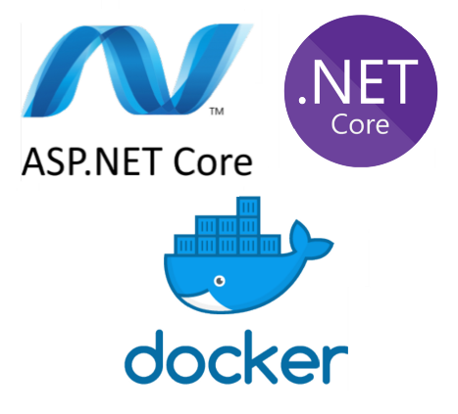
AGENDA
Docker architecture
Docker-compose
Build a .NET Docker app
Debugging multiple .NET Containers

Slide 3
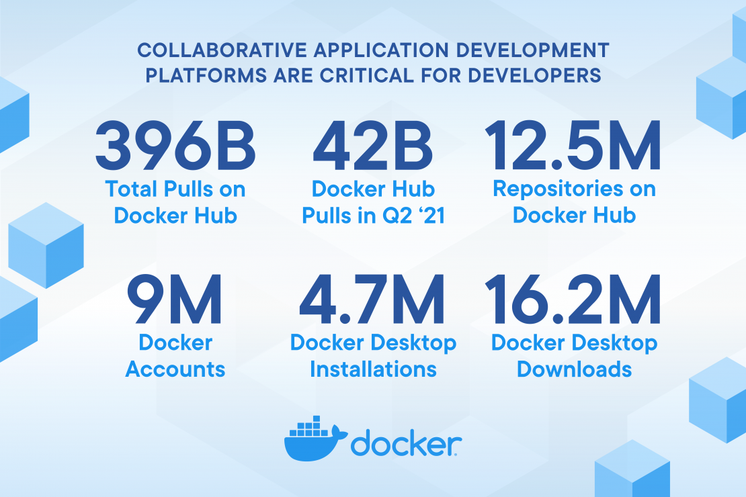
Docker is growing

Slide 4
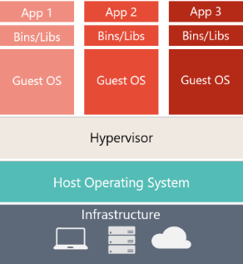
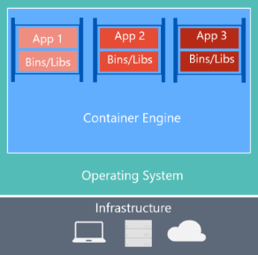
Docker architecture
Virtual Machines
Docker containers

Slide 5
Running Containers
Can be Linux or Windows based
Are isolated from the host OS (but Windows based containers require a Windows host OS)
Only see their own “file system (app/libs)”, not the host filesystem
Images are layer based
Use their own networking (internal – bridged (default) – host- overlay)
Docker engine will forward kernel calls to the Host OS kernel
Images are pushed to a registry to be shared with others

Slide 6
Docker Terminology
DEV
OPS
Image (a set of layered zip files)
Dockerfile
Build
Tag
Container (a runnig instance of an image)
Volume (mount disk/folders with the host OS/SAN/…)
Registry (share images)
Docker Hub
Azure Container Registry (Azure)
Elastic Container Register (AWS)
Docker Trusted Registry (DTR)
Docker Engine
Docker Desktop
Rancher Desktop
Podman
(Docker-)Compose (collaborating containers)
Cluster
Orchestrator
Kubernetes
Service Fabric
Docker Swarm
https://learn.microsoft.com/en-us/dotnet/architecture/microservices/container-docker-introduction/docker-terminology

Slide 7
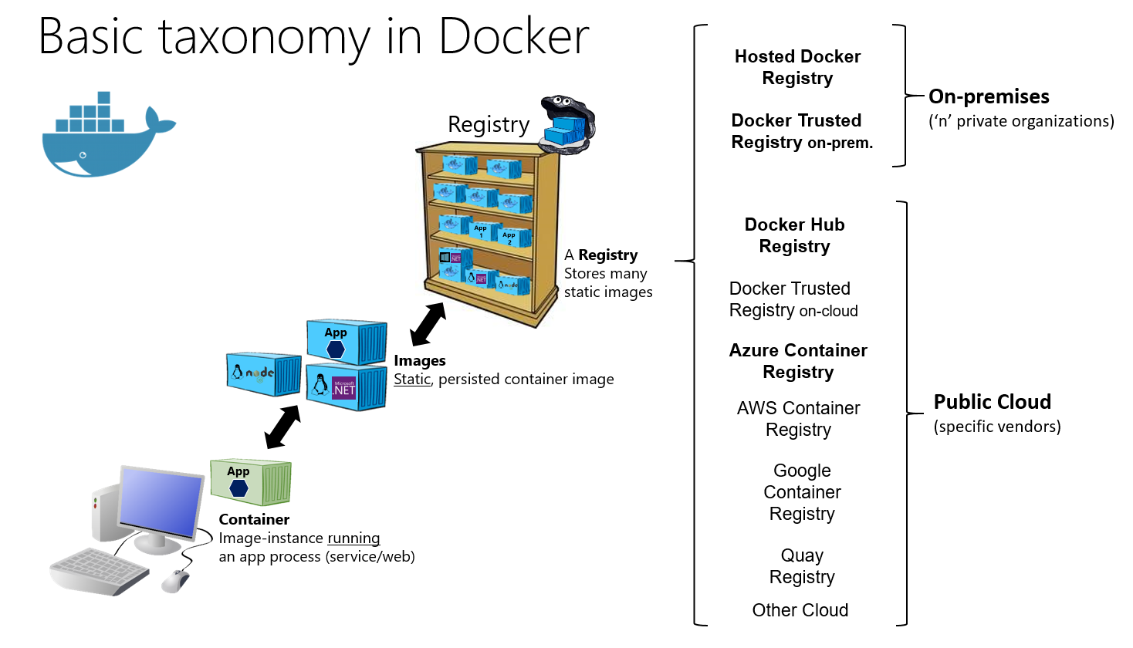
Docker taxonomy

Slide 8
Docker Engines
Docker desktop (https://docs.docker.com/desktop/install/windows-install/) -> license(!)
Rancher desktop (https://rancherdesktop.io/)
Podman (https://podman.io/)
GUI
Portainer (https://docs.portainer.io/v/ce-2.9/start/install/server/docker/wsl#deployment)

Slide 9
Docker-cli
Let’s play…
docker pull
docker images
docker run
docker ps –a
docker run -it busybox sh
docker container prune
docker network ls
dive
Notes:
https://docker-curriculum.com/#hello-world

Slide 10
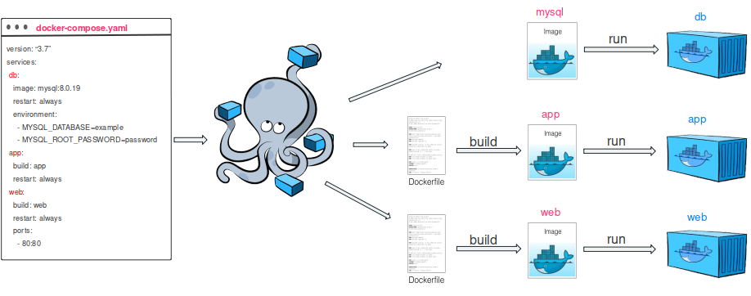
Docker-compose
Multiple containers working together

Slide 11
.NET and Docker
Example 1: Let’s build a .NET Docker container together, showing:
Docker container support
Docker orchestration support
Source: https://github.com/gvangeel/dotnet-loves-docker
Example 2: Let’s try another example this time with multiple containers:
Guide : https://learn.microsoft.com/en-us/visualstudio/containers/tutorial-multicontainer?source=recommendations&view=vs-2022
Source: https://github.com/MicrosoftDocs/vs-tutorial-samples/tree/master/docker/ComposeSample

Slide 12
What’s Beyond
Visual Studio Container Tools: https://learn.microsoft.com/en-us/visualstudio/containers/?view=vs-2022
Kubernetes (https://kubernetes.io/)
Debugging .NET Kubernetes Containers in Visual Studio (Bridge to Kubernetes)
https://learn.microsoft.com/en-us/visualstudio/bridge/bridge-to-kubernetes-vs
Source: https://github.com/gvangeel/dotnet-loves-docker

Slide 13
Q&A

Slide 14
About Capgemini
Capgemini is a global leader in partnering with companies to transform and manage their business by harnessing the power of technology. The Group is guided everyday by its purpose of unleashing human energy through technology for an inclusive and sustainable future. It is a responsible and diverse organization of over 325,000 team members more than 50 countries. With its strong 55-year heritage and deep industry expertise, Capgemini is trusted by its clients to address the entire breadth of their business needs, from strategy and design to operations, fueled by the fast evolving and innovative world of cloud, data, AI, connectivity, software, digital engineering and platforms. The Group reported in 2021 global revenues of €18 billion.
Get The Future You Want | www.capgemini.com

